Slide 1
AI/ML MINOR DEGREE PROJECT
TruthLens AI
Agentic AI for Explainable Misinformation Detection
Submitted by: Dikshant Aggarwal (Roll No. 12303021)
Submitted to: Dr. Chandan Deep Singh
University: Punjabi University, Patiala
Notes:
Good morning. I'm Dikshant Aggarwal, roll number 12303021. My minor-degree project is TruthLens AI - an agentic, explainable system for detecting misinformation, guided by Dr. Chandan Deep Singh. Over the next slides I'll cover the problem, my solution, the architecture, the results, and a live demo.

Slide 2
Problem Statement
The challenge
GOAL
Generative AI has made fake news cheap, fluent and convincing - produced faster than humans can fact-check it.
Misinformation distorts elections, public health, and financial markets.
A bare 'FAKE' label isn't enough - users and moderators need reasons and evidence they can trust.
Many solutions need paid APIs or the cloud - impractical for offline, low-cost use.
Given any article, decide REAL vs FAKE -
accurately
explainably
grounded in evidence
fully offline, no API key
TruthLens AI
2 / 20
Notes:
The core problem: generative AI lets anyone mass-produce believable fake news. Manual fact-checking can't keep up, and a black-box label nobody can question isn't useful. My goal was a system that is accurate, explainable, evidence-grounded, and runs offline at zero cost so it can be demoed anywhere.

Slide 3
Objectives
1
Accurate classifier
2
Explainability
3
RAG fact-check
Distinguish real vs fake news with an interpretable ML model.
Expose the linguistic signals and terms behind each verdict.
Ground verdicts in a verified knowledge base via retrieval.
4
Agentic design
5
Generative AI
6
Production quality
Coordinate specialised agents with a transparent reasoning trace.
Natural-language explanations with a guaranteed offline fallback.
Modern UI, modular code, tests, and full documentation.
TruthLens AI
3 / 20
Notes:
Six objectives drove the design: an accurate interpretable classifier; an explainability layer; retrieval-augmented fact-checking; an agentic architecture with a visible reasoning trace; generative-AI explanations with an offline fallback; and an overall production-quality build with a modern UI, tests and docs.

Slide 4
Current Challenges
Scale & speed
GenAI produces misinformation faster than fact-checkers can respond.
Black-box models
High-accuracy deep models rarely explain why - eroding trust.
Evidence gap
Most classifiers give a label but no supporting references.
Cost & connectivity
Cloud LLM APIs add cost and fail without internet.
Data realism
Clean benchmarks overstate accuracy vs messy real-world text.
TruthLens AI
4 / 20
Notes:
Five challenges this project tackles: the sheer scale and speed of GenAI misinformation; the opacity of black-box models; the lack of supporting evidence in most classifiers; the cost and connectivity needs of cloud APIs; and the gap between clean benchmarks and messy real-world data, which inflates reported accuracy.

Slide 5
Proposed Solution - TruthLens AI
A 3-in-1 pipeline: classify, explain, and fact-check - fused into one trustworthy, offline verdict.
Interpretable ML
Explainability engine
RAG fact-check
Agentic GenAI
TF-IDF + Logistic Regression with per-article term attribution.
Transparent linguistic credibility signals - no black box.
Semantic retrieval of verified statements to ground the verdict.
3 agents + local-LLM explanation with an offline template fallback.
Outcome: 94.2% accuracy - 0.947 ROC-AUC - fully offline, no API key - live, explainable verdicts in milliseconds.
TruthLens AI
5 / 20
Notes:
My solution combines four layers: an interpretable TF-IDF + logistic-regression classifier; a transparent linguistic-signal explainability engine; a retrieval-augmented fact-check component; and an agentic generative-AI layer with an offline fallback. Together they deliver 94.2% accuracy and 0.947 AUC while running entirely offline.

Slide 6
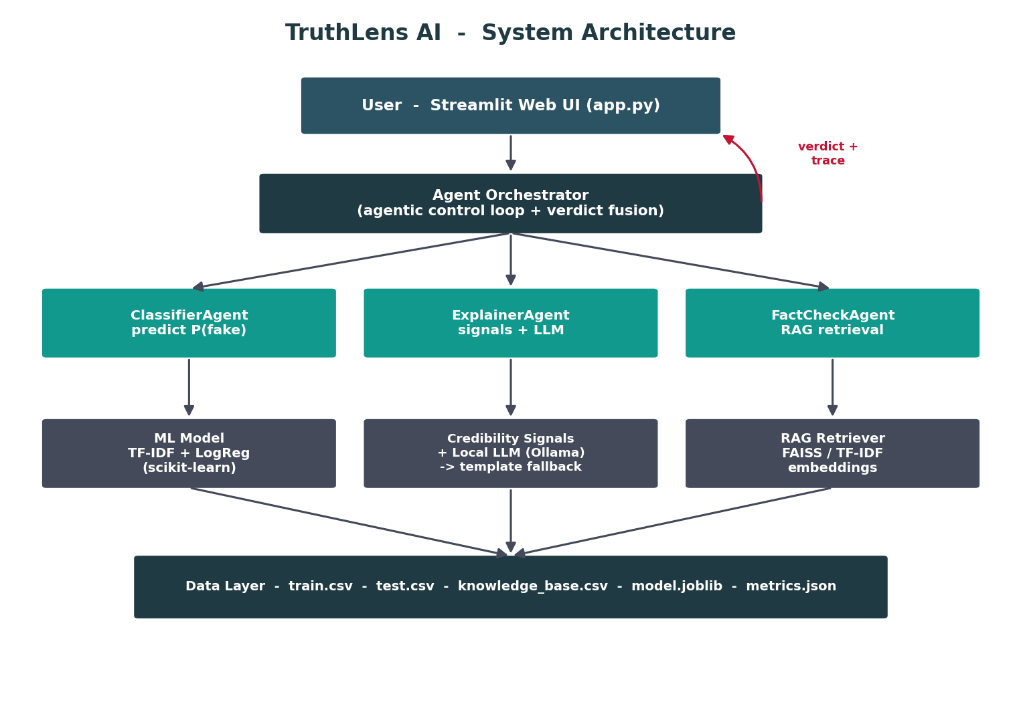
System Architecture
Layers
Streamlit UI
Agent Orchestrator
3 specialised agents
ML model / signals+LLM / RAG
Data + artifacts layer
TruthLens AI
6 / 20
Notes:
The architecture is layered. The Streamlit UI calls an orchestrator, which runs three specialised agents. Each agent is backed by an engine - the ML model, the signal-and-LLM explainer, and the RAG retriever - over a data layer holding the dataset, knowledge base and trained model. The orchestrator returns a verdict plus a full reasoning trace shown to the user.

Slide 7
Technology Stack
Language & ML
Interface
Python 3 - scikit-learn - NumPy - pandas
Streamlit - Plotly / Matplotlib
Retrieval (RAG)
Generative AI
FAISS + sentence-transformers - TF-IDF fallback
Ollama (local LLM) - deterministic template fallback
Agents
Tooling & QA
Custom multi-agent orchestrator (CrewAI-style)
pytest - joblib - Git - modular package layout
TruthLens AI
7 / 20
Notes:
The stack is deliberately lightweight and industry-standard: Python with scikit-learn, NumPy and pandas for ML; Streamlit for the UI; FAISS with sentence-transformers - and a TF-IDF fallback - for retrieval; Ollama for an optional local LLM; a custom multi-agent orchestrator; and pytest plus a clean package layout for quality.

Slide 8
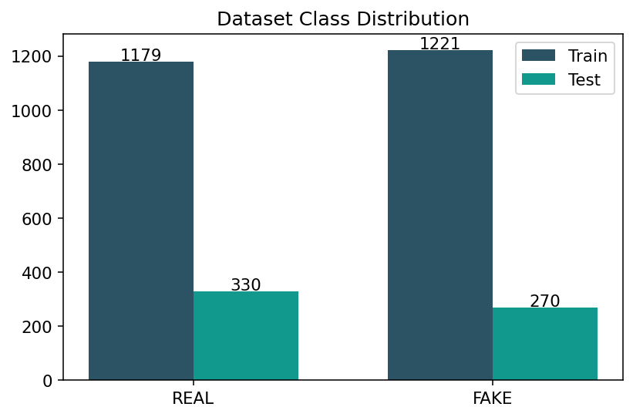
Dataset
3,000
balanced articles
2,400 / 600
train / test split
~5%
injected label noise
18
KB reference statements
Schema: title, text, label (0=REAL, 1=FAKE). Auto-loads the real Kaggle set if True.csv / Fake.csv are added.
TruthLens AI
8 / 20
Notes:
The dataset has 3,000 balanced articles, split 2,400 train / 600 test. A realistic generator injects cross-class overlap and about five percent label noise so the data isn't trivially separable - this keeps metrics honest. A knowledge base of 18 verified statements supports the fact-check agent, and the loader switches to the real Kaggle dataset automatically if its files are added.

Slide 9
Machine Learning Model
Pipeline
Trained model - key facts
1. Clean text (URLs / HTML / stopwords removed)
2. TF-IDF vectorise (unigrams + bigrams)
3. Logistic Regression (balanced, calibrated P)
4. Term attribution = coef x tf-idf -> explainable
Algorithm
TF-IDF + LogReg
Vocabulary
1,500 features
Cross-val
94.8% (+/- 0.8%)
Why TF-IDF + Logistic Regression?
Test accuracy
94.2%
Fast, low-data friendly, and fully interpretable - you can see exactly which words drove every decision.
ROC-AUC
0.947
TruthLens AI
9 / 20
Notes:
The core is a four-step pipeline: clean the text, vectorise with TF-IDF over unigrams and bigrams, classify with a balanced logistic regression that outputs a calibrated probability, and compute term attributions as coefficient times TF-IDF. I chose this model because it's fast, works with limited data, and is fully interpretable - giving 94.2% test accuracy and 0.947 AUC.

Slide 10
Generative AI / Agentic AI Components
1
ClassifierAgent
2
ExplainerAgent
3
FactCheckAgent
Runs the ML model - returns P(fake) and the most influential terms.
Extracts credibility signals; writes the explanation via local LLM or template.
RAG: retrieves top-k verified statements to ground the verdict.
Agentic orchestration + graceful degradation
An orchestrator runs the agents in sequence, fuses their outputs (0.70 x model + 0.30 x signal-risk), and returns a verdict with a full reasoning trace. If no local LLM is present, explanations fall back to a deterministic template - so the GenAI layer ALWAYS works offline.
TruthLens AI
10 / 20
Notes:
This is the agentic and generative-AI heart of the project. Three agents cooperate: ClassifierAgent runs the model, ExplainerAgent produces the natural-language explanation using a local LLM or a template, and FactCheckAgent does retrieval-augmented grounding. An orchestrator fuses their outputs and exposes the whole reasoning trace. Crucially, if no LLM is available it degrades gracefully to templates, so it always works offline.

Slide 11
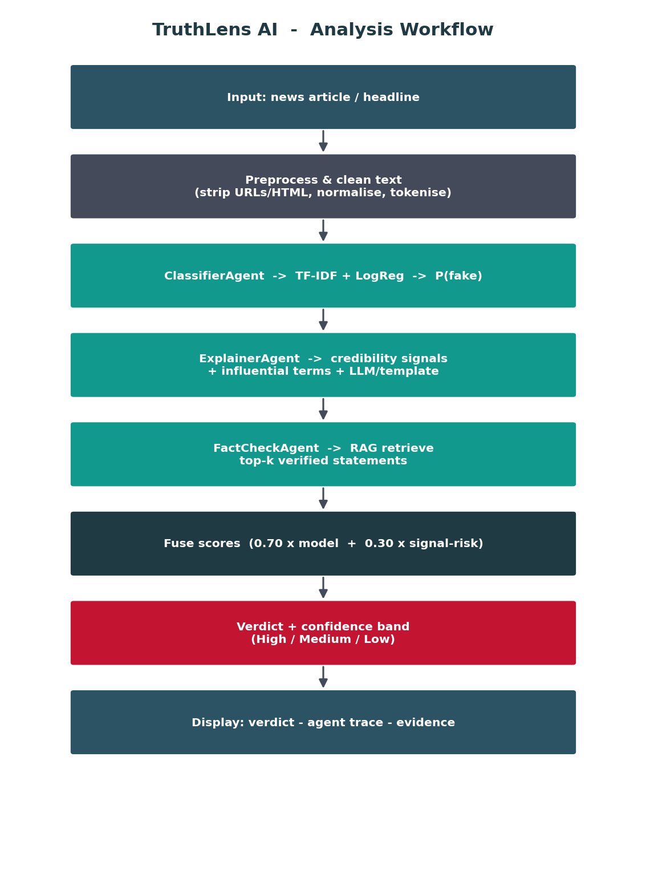
Workflow
Flow
Fusion
Input article
Preprocess
Classify
Explain
Fact-check (RAG)
Fuse scores
Verdict + trace
Final score
0.70 x model
+ 0.30 x signals
Confidence band:
High / Medium / Low
TruthLens AI
11 / 20
Notes:
End to end: the article is preprocessed, then the three agents run - classify, explain, fact-check. Their outputs are fused with a 70/30 weighting between the model probability and the transparent linguistic risk score. That produces the verdict, a confidence band, and the full trace the user sees.

Slide 12
Implementation
Project structure
Modular package
source_code/
app.py Streamlit UI
src/
config · preprocessing
features · model · train
retrieval · llm
agents/ (4 modules)
tests/ (pytest suite)
models/ metrics.json
Clear separation: UI, model, agents, retrieval.
Error handling
UI never crashes on bad input; safe LLM/retrieval fallbacks.
Tested
pytest covers preprocessing, signals, full pipeline.
One-command run
Auto-trains on first launch; run.bat / run.sh.
TruthLens AI
12 / 20
Notes:
The implementation follows a clean, production-style layout: a Streamlit app over a src package split into config, preprocessing, features, model, training, retrieval, the LLM client, and the agents. There's a pytest suite, centralised configuration, defensive error handling so the UI never crashes, and one-command launch that auto-trains on first run.

Slide 13
User Interface
localhost:8501 - TruthLens AI
UI highlights
Verdict: FAKE
Colour-coded verdict card
Live confidence & latency
Visible agent trace
Signals & influential terms
Retrieved evidence (RAG)
One-click sample articles
Confidence: 91% (High) - Likely misinformation; verify before sharing.
0.86
0.89
0.78
42 ms
Fused
P(fake)
Signal risk
Latency
Agentic reasoning pipeline
ClassifierAgent - predicts FAKE (P=0.89)
ExplainerAgent - sensational + clickbait markers
FactCheckAgent - retrieved 3 references (RAG)
TruthLens AI
13 / 20
Notes:
Here's the interface, built in Streamlit. The user pastes an article and gets a colour-coded verdict card - red for fake, green for real - with confidence, the fused score, latency, and the full agent trace. Tabs reveal the linguistic signals, the most influential model terms, and the RAG-retrieved evidence. One-click sample buttons make the live demo effortless. I'll show this running shortly.

Slide 14
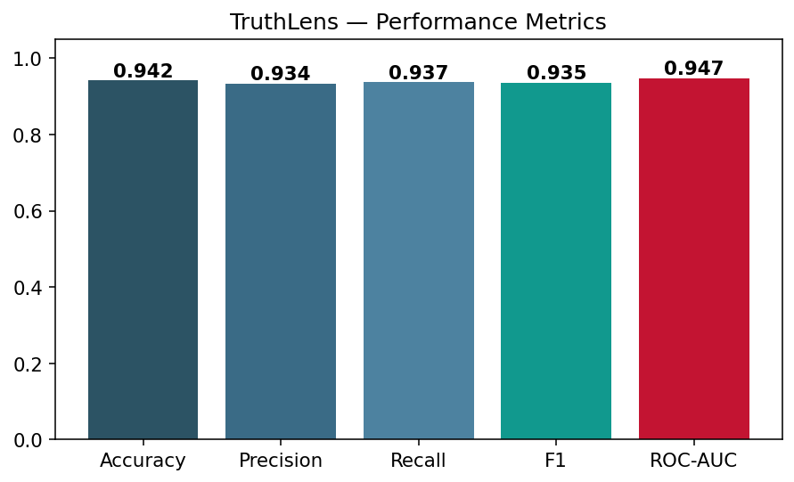
Results
94.2%
0.947
93.5%
94.8%
Accuracy
ROC-AUC
F1 (fake)
CV accuracy
Takeaways
Strong, balanced precision & recall
High AUC = robust across thresholds
Tiny CV-vs-test gap = no overfitting
Realistic data (not a 100% mirage)
TruthLens AI
14 / 20
Notes:
The headline results: 94.2% accuracy, 0.947 ROC-AUC, 93.5% F1 on fake, and 94.8% cross-validated accuracy. Precision and recall are balanced, the high AUC means robustness across thresholds, and the tiny gap between cross-validation and test accuracy shows it generalises without overfitting. Importantly these numbers come from realistically noisy data, not a trivially perfect benchmark.

Slide 15
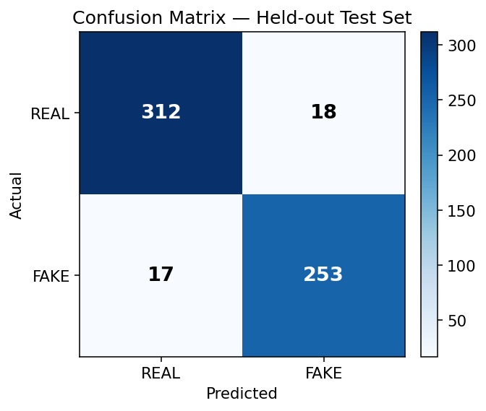
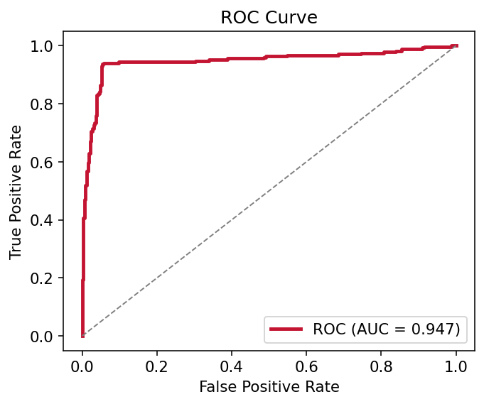
Performance Metrics
Test set
TN
312
FP
18
FN
17
TP
253
Acc
94.2%
AUC
0.947
Confusion matrix (left) and ROC curve (right) on the 600-article held-out test set.
TruthLens AI
15 / 20
Notes:
Drilling into performance: the confusion matrix shows only 18 false positives and 17 false negatives out of 600 - errors are low and balanced. The ROC curve hugs the top-left corner with an AUC of 0.947, confirming strong separability. These are the metrics I'd defend in a viva: honest, reproducible, and computed on a held-out set.

Slide 16
Advantages
+
Explainable
+
Offline & free
+
Robust by design
Every verdict comes with signals, terms and evidence.
No API key, no cloud - runs on any laptop.
Graceful fallbacks for LLM and retrieval.
+
Fast
+
Interpretable ML
+
Industry-relevant
Millisecond inference - ideal for live demos.
Linear model you can fully reason about.
RAG + agents + classic ML in one project.
TruthLens AI
16 / 20
Notes:
The advantages: it's explainable, with signals, terms and evidence behind every verdict; it's offline and free; it's robust thanks to graceful fallbacks; it's fast enough for live demos; the ML is fully interpretable; and it's industry-relevant, packing RAG, agents and classical ML into one coherent project.

Slide 17
Real-World Applications
Social platforms
Newsrooms
1
2
Flag and explain suspect posts before they go viral.
Assist journalists in triaging and verifying sources.
Education
Fact-check orgs
3
4
Teach media literacy with transparent, explainable signals.
Prioritise high-risk content for human review.
Messaging apps
Brand / PR
5
6
On-device checks for forwarded content - privacy-safe.
Monitor misinformation about organisations in real time.
TruthLens AI
17 / 20
Notes:
TruthLens has broad applications: social platforms flagging viral fakes; newsrooms triaging sources; education teaching media literacy through transparent signals; fact-check organisations prioritising review; on-device checks in messaging apps for privacy; and brand monitoring for PR teams. The offline, explainable design fits all of these.

Slide 18
Future Scope
1
Transformer upgrade
Fine-tune DistilBERT/RoBERTa; ensemble with the linear model.
2
Live evidence
Connect reputable real-time fact-check feeds to the RAG layer.
3
Multilingual
Detect misinformation beyond English.
4
Multimodal
Add image, metadata and source-reputation signals.
5
Deployment
Browser extension + REST API for platform integration.
6
Human-in-the-loop
Feedback loop to retrain and recalibrate continuously.
TruthLens AI
18 / 20
Notes:
Future work: upgrade to a fine-tuned transformer and ensemble it with the linear model; connect live fact-check feeds for fresher grounding; add multilingual and multimodal signals; ship a browser extension and REST API; and add a human-in-the-loop feedback path to continuously retrain and recalibrate.

Slide 19
Conclusion
TruthLens AI reframes fake-news detection as an explainable, evidence-grounded, multi-agent workflow - not a black-box label.
94.2% accuracy and 0.947 ROC-AUC on realistic data.
Interpretable ML + explainability + RAG + agentic GenAI in one system.
Runs fully offline on a laptop - no API key, no cost, demo-ready.
Showcases the exact skills 2026 AI internships hire for.
An academically rigorous project, engineered to industry standards.
Notes:
To conclude: TruthLens reframes detection as an explainable, evidence-grounded, multi-agent workflow. It achieves 94.2% accuracy and 0.947 AUC on realistic data, combines interpretable ML with explainability, RAG and agentic GenAI, runs entirely offline, and demonstrates the precise skills that 2026 AI internships look for. Thank you - I'm happy to take questions and give a live demo.

Slide 20
Thank You
Questions & Live Demo Welcome
Dikshant Aggarwal - Roll No. 12303021 - Punjabi University, Patiala
Guide: Dr. Chandan Deep Singh
Notes:
Thank you for your attention. I'd be glad to answer questions and run a live demonstration of TruthLens AI.

